Slide 1
Proposed Revisions to District Board of Health Regulations Governing Air Quality Management Chapter 030
Francisco Vega – July 8, 2024
Director, Air Quality Management Division

Slide 2
Air Quality Management Division
Mission
The Air Quality Management Division (AQMD) implements clean air solutions that protect the quality of life for the citizens of Reno, Sparks, and Washoe County through community partnerships along with programs and services such as air monitoring, permitting, compliance, planning, and public education.

Slide 3
District Board of Health
Strategic Priority
2. Healthy Environment: Create a healthier environment that allows people to safely enjoy everything Washoe County has to offer.
2.1 Protect people from negative environmental impacts.

Slide 4
Chapter 030 Source Permitting (Proposed Revision)
Background
Chapter 030 establishes the requirements for air pollution control and air quality permitting for sources of regulated air pollutants located within Washoe County.
These requirements are used to protect public health and welfare.
Establishes minimum thresholds for air quality permitting, air pollution control requirements, and exemptions from air quality permitting requirements.
Also establishes application, monitoring, reporting, recordkeeping, and testing requirements.

Slide 5
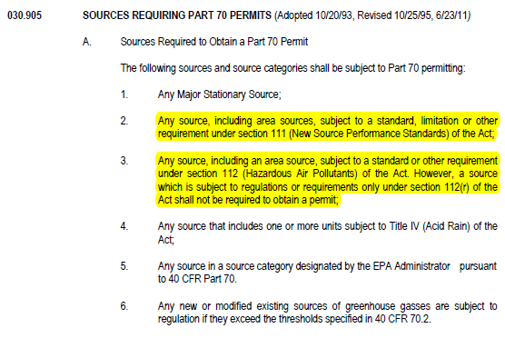
Chapter 030 Source Permitting (Proposed Revision)
Why
Regulation is incorrect in many instances.
Example: 030.905
Many requirements are outdated.
Most parts of the regulation have not been updated for 20-30 years.
Does not reflect current best practices for air quality source permitting.
Permits renewed annually as opposed to once every 5 years.
Not clear and/or transparent.
Structure
Definitions
Different programs intermingled

Slide 6
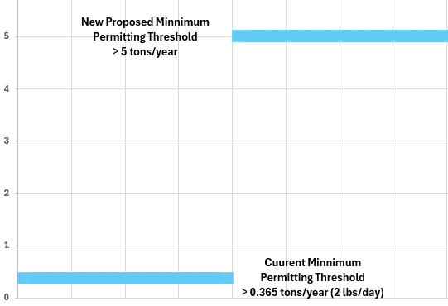
Chapter 030 Source Permitting (Proposed Revision)
Major Changes
Minimum Permitting Thresholds
Proposed to be increased from 0.365 tons per year (2 lbs/day) to 5 tons per year.
Permit Renewal Timeframe
Proposed to change from an annual requirement to 5 years.
Exemptions
Clear and transparent list of exempt and insignificant activities.
Best System of Control
Clearly defines when projects require additional air pollution controls.

Slide 7
Chapter 030 Source Permitting (Proposed Revision)
Major Changes
Structure
Different permitting programs have been broken out into different parts.
General Permitting
Part 030.100 will allow for the issuance of general permits for similar sources.
Definitions
All definitions have been corrected and updated
Fee Structure
Annual Emissions and General Permits

Slide 8
Chapter 030 Source Permitting (Proposed Revision)
Structure
Part 030.000 - General Provisions
Part 030.100 - General Permitting
Part 030.200 - Minor Sources
Provides general guidance on the air quality permitting program.
Establishes requirements for the permitting of general sources.
Establishes requirements for the permitting of minor sources.
Part 030.300 - Nonattainment New Source Review
Part 030.400 - Prevention of Significant Deterioration
Part 030.500 - Part 70
Establishes requirements for the permitting of major stationary sources in nonattainment areas.
Establishes requirements for the permitting of major stationary sources in attainment areas.
Establishes requirements for the permitting of major sources.

Slide 9
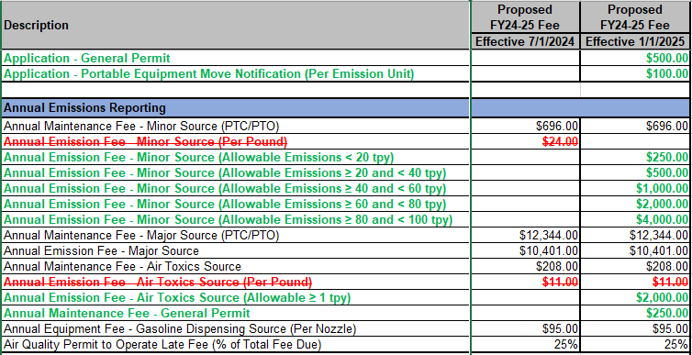
Chapter 030 Source Permitting (Proposed Revision)
Fee Structure

Slide 10
Chapter 030 Source Permitting (Proposed Revision)
Timeline
July 8, 2024
August 8, 2024
August 22, 2024
September 26, 2024
Start of the 30-Day Public Comment Period and Public Workshop.
Close of 30-Day Public Comment Period and Public Workshop
Business Impact Statement presented to District Board of Health
Public Hearing and Rule Adoption presented to District Board of Health
* Implementation date for the proposed revisions will be January 1, 2025

Slide 11
Chapter 030 Source Permitting (Proposed Revision)
Public Engagement
Public comment will be accepted through August 8th.
May be submitted via email at HealthAirQuality-Planning@nnph.org
May be submitted via mail at
1001 E. Ninth St., Bldg. B-171, Reno, NV, 89512
May be dropped off in person in the air quality drop box located at the address above
All correspondence must include first and last name, mailing address, and contact information.
To view the proposed changes to Chapter 030, recording of this public workshop, and slides from this presentation, please visit the Public Outreach page of our website.
OurCleanAir.com

